Slide 1


Publicly available bioinformatics resources
Volos Summer School
30 / 05 / 2017
Konstantinos Hatzikotoulas

Slide 2
Motivation
Greatest challenge in genetic association studies is to assign functionality (causality) to associated SNPs and genes.
Predict the most likely genes and variants driving the phenotype associations.
Need to integrate as much information as possible through genome annotation tools to drive the experimental validation.

Slide 3
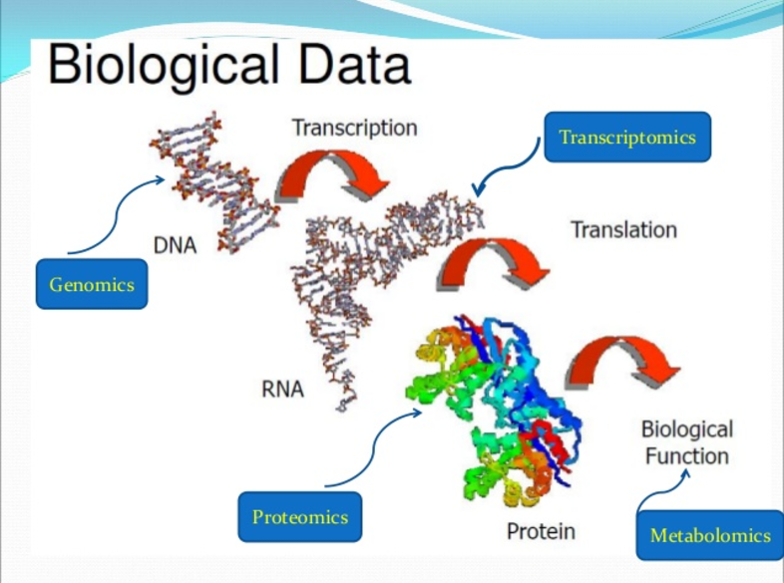

What is Bioinformatics?
+
Computers aid to collect, intergrade and analyse biological data -> Optimal biological interpretation

Slide 4
Goal of Bioinformatics
Develop databases and computational tools to generate knowledge to better understanding a living cell and how it functions at molecular level.

Slide 5
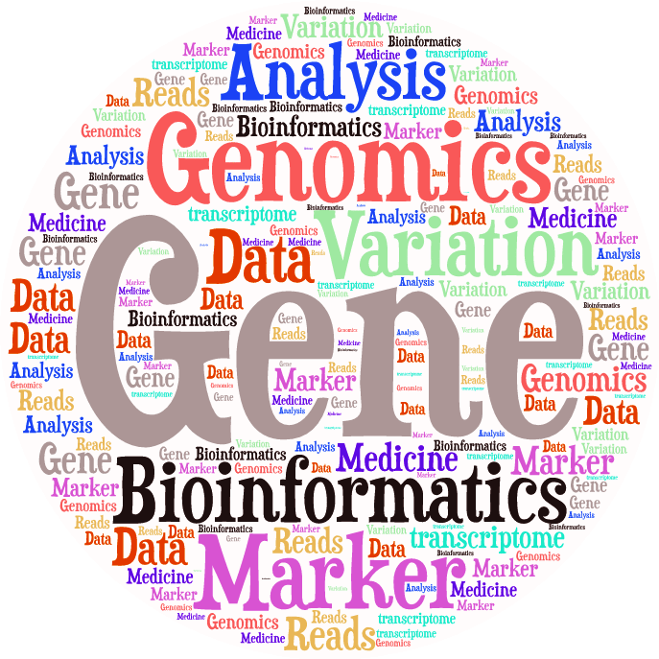
Publicly available bioinformatics
resources
Genome Browsers
Nucleotide Sequence Databases
Protein Sequence Databases
Database Searching by Sequence Similarity
Protein Domains: Databases and Search Tools
Human Traits & Diseases Databases
Phylogeny & Taxonomy
Databases of other Organisms
Gene Prediction
Gene Expression Databases
Gene Regulation
Metabolic, Gene Regulatory & Signal Transduction Network Databases
Publications Database

Slide 6
Publicly available bioinformatics
resources
Genome Browsers
Nucleotide Sequence Databases
Protein Sequence Databases
Database Searching by Sequence Similarity
Protein Domains: Databases and Search Tools
Human Traits & Diseases Databases
Phylogeny & Taxonomy
Databases of other Organisms
Gene Prediction
Gene Expression Databases
Gene Regulation
Metabolic, Gene Regulatory & Signal Transduction Network Databases
Publications Database

Slide 7



Genome Browsers
Ensembl : http://www.ensembl.org
UCSC: http://genome.ucsc.edu/
NCBI: https://www.ncbi.nlm.nih.gov/

Slide 8
Genome Browsers
Agreement on:
Genomes to annotate
Consistent genomic coordinates
…

Slide 9
Ensembl … more than a browser!
Ensembl is a joint project between the EBI (European Bioinformatics Institute) and the Wellcome Trust Sanger Institute
What can I do with Ensembl?
Examine single nucleotide polymorphisms (SNPs) for a gene or chromosomal region.
View SNPs across strains (rat, mouse), populations (human) or breeds (dog).
View genes with annotations along the chromosome.
View alternative transcripts (i.e. splice variants) for a given gene.
Upload your own data.
Export sequence or create a table of gene information with BioMart.
Determine how your variants affect genes and transcripts using the Variant Effect Predictor.
Share Ensembl views with your colleagues and collaborators.

Slide 10
Ensembl … more than a browser!
Ensembl is a joint project between the EBI (European Bioinformatics Institute) and the Wellcome Trust Sanger Institute
What can I do with Ensembl?
Examine single nucleotide polymorphisms (SNPs) for a gene or chromosomal region.
View SNPs across strains (rat, mouse), populations (human) or breeds (dog).
View genes with other annotation along the chromosome.
View alternative transcripts (i.e. splice variants) for a given gene.
Upload your own data.
Export sequence or create a table of gene information with BioMart.
Determine how your variants affect genes and transcripts using the Variant Effect Predictor.
Share Ensembl views with your colleagues and collaborators.

Slide 11
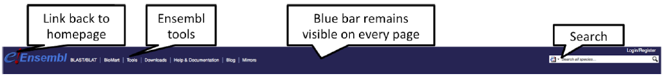
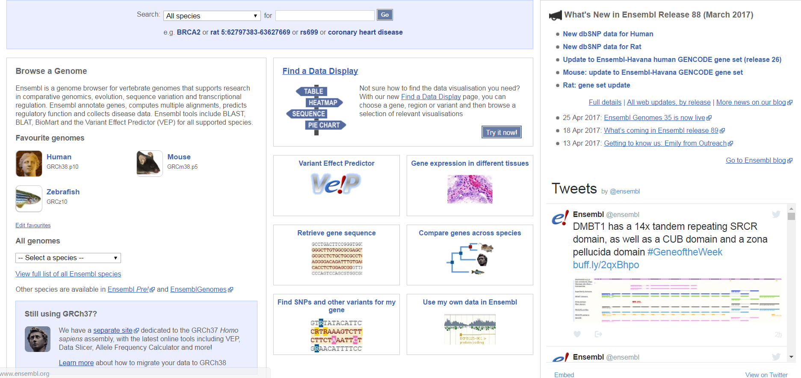

Ensembl … the front page
It contains lots of information and links to help you navigate Ensembl.
Hint: http://ensemblgenomes.org/

Slide 12

Ensembl … the front page … Exercise 1
Go to the species homepage for Panda. What is the name of the genome assembly for Panda?
How long is the Panda genome (in bp)? How many genes have been annotated?
Repeat for Human.

Slide 13
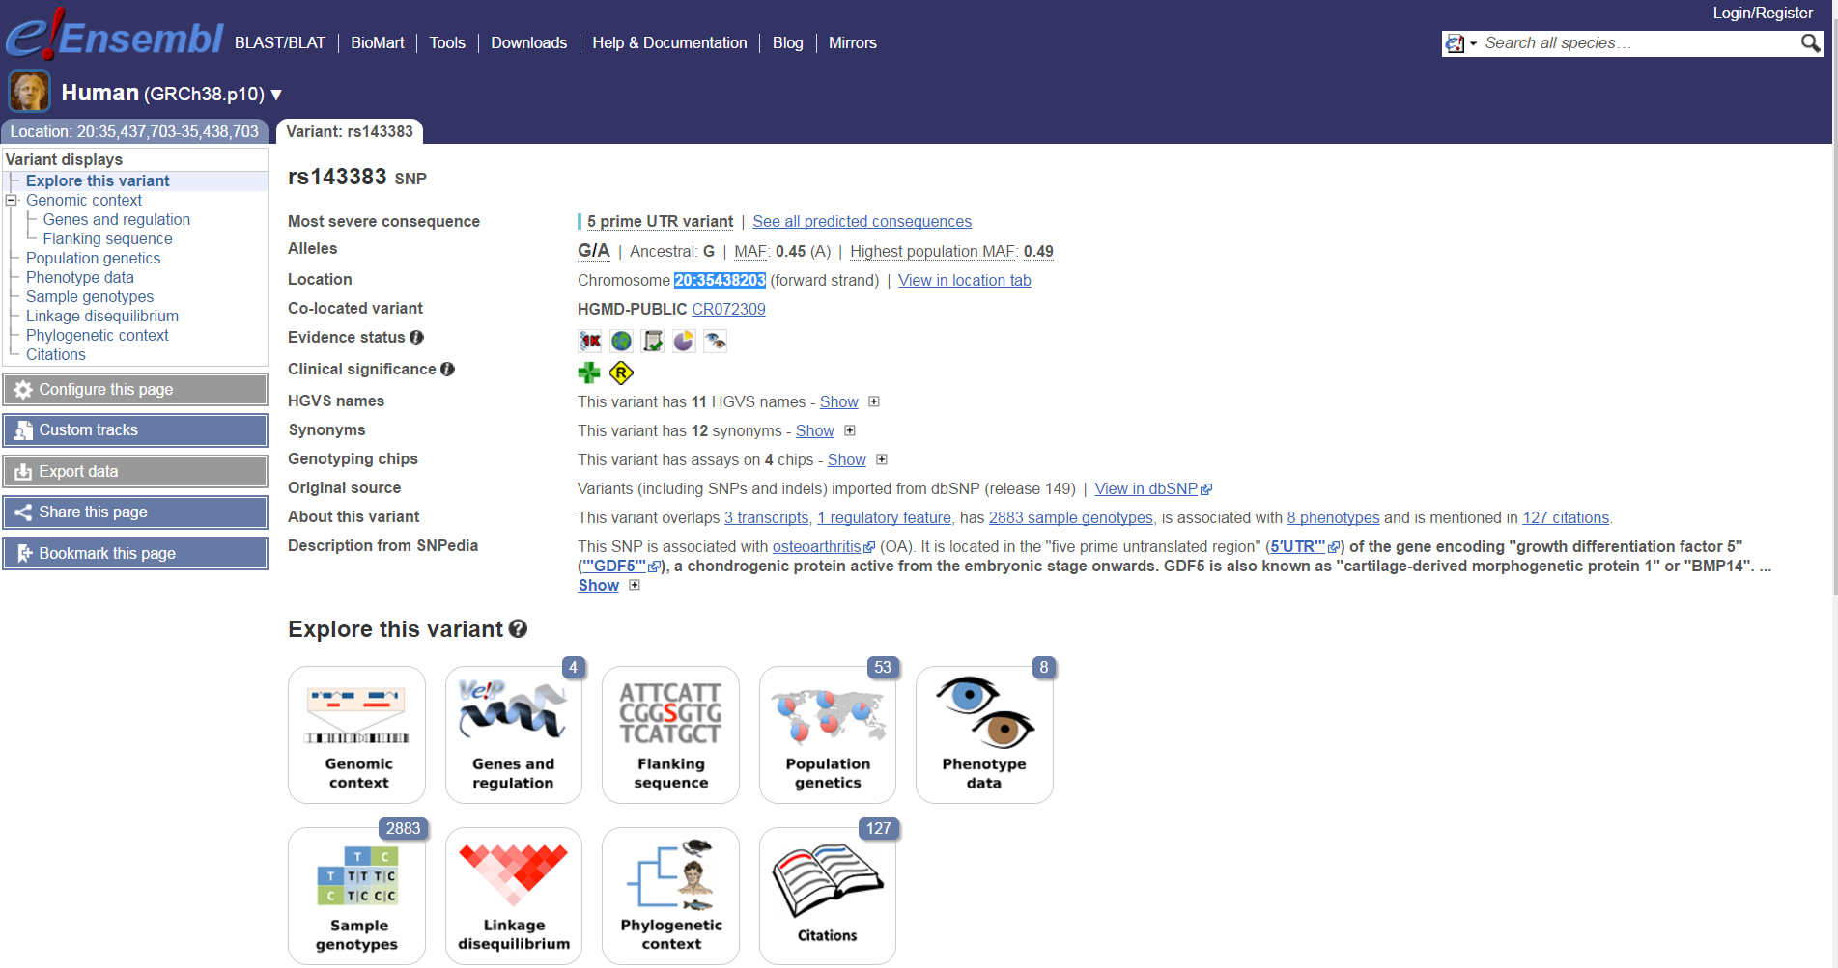
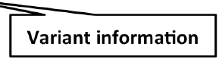
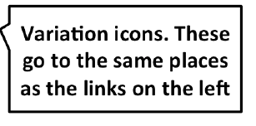
Ensembl … Exploring variants
Let’s have a look at a specific variant, rs143383 (chr20:35438203).
http://www.ensembl.org/info/genome/variation/predicted_data.html

Slide 14
Ensembl … Exploring variants
What type of variants is rs143383 (chr20:35438203)?
http://www.ensembl.org/info/genome/variation/predicted_data.html

Slide 15
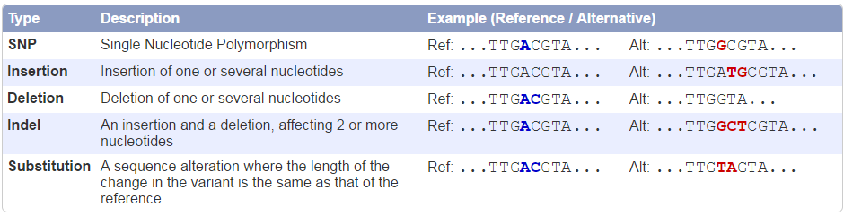
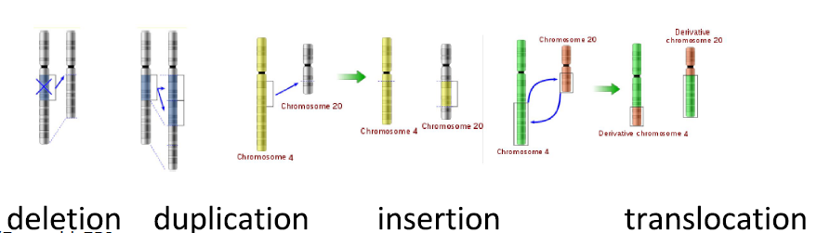
Ensembl … Exploring variants …
variant types
Small scale in one or few nucleotides of a gene
Large scale in chromosomal structure

Slide 16
Ensembl … Exploring variants
Let’s have a look at the predicted consequences of the variant.
http://www.ensembl.org/info/genome/variation/predicted_data.html

Slide 17
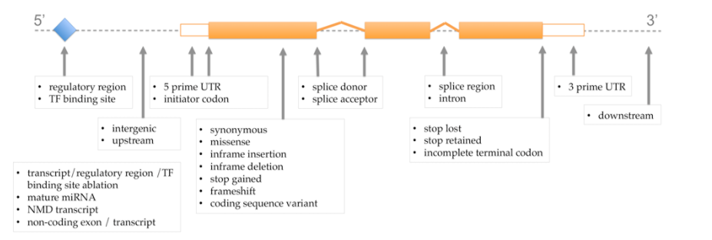
Ensembl … Exploring variants …
Calculated variant consequences
Ensembl identifies each transcript that overlaps with the variant.
Then they use a rule-based approach to predict the effects that each allele of the variant may have on the transcript.

Slide 18
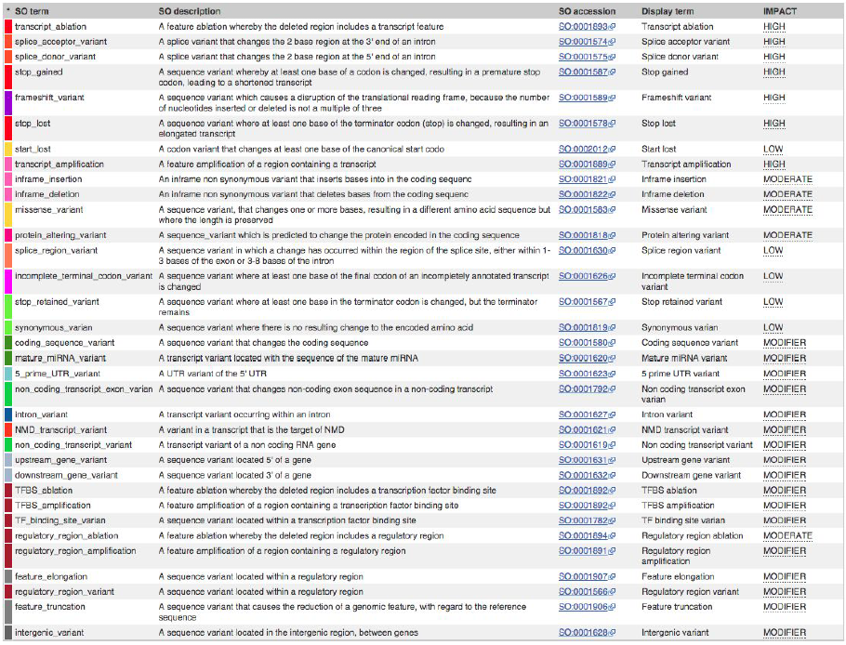
Ensembl … Exploring variants …
Calculated variant consequences
Sequence Ontology (SO) consequence term :
http://www.ensembl.org/info/genome/variation/predicted_data.html

Slide 19
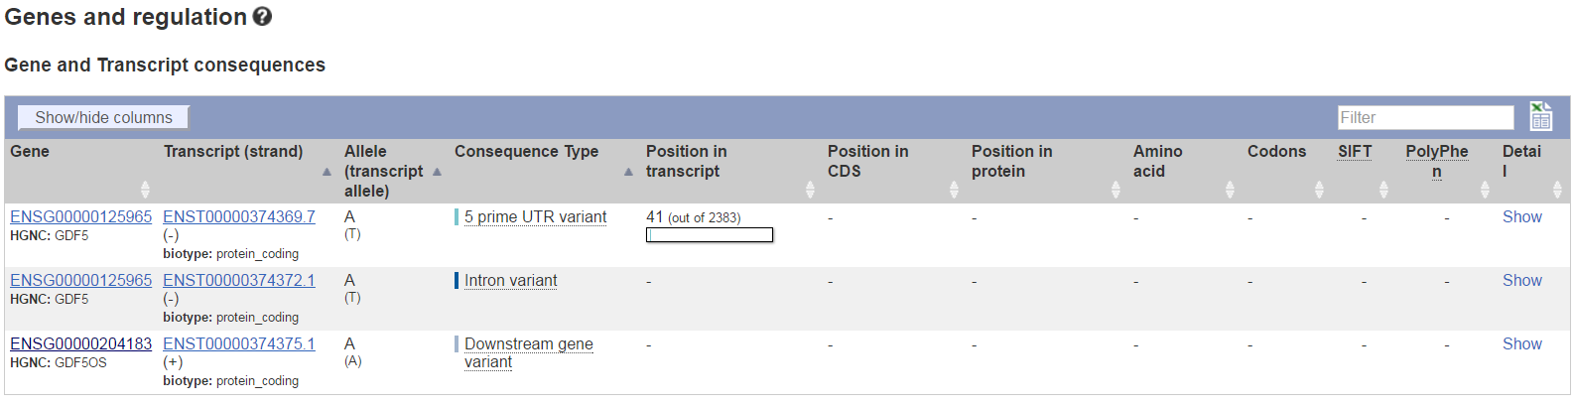
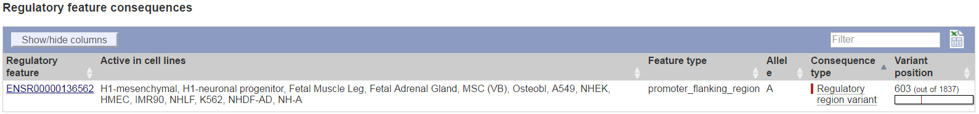
Ensembl … Exploring variants …
Calculated variant consequences
This variant is found in 3 transcripts of the GDF5 gene.
It has been associated with 1 regulatory feature (http://www.ensembl.org/info/genome/funcgen/index.html ).

Slide 20
Ensembl … Exploring variants
Let’s have a look at population genetics.

Slide 21
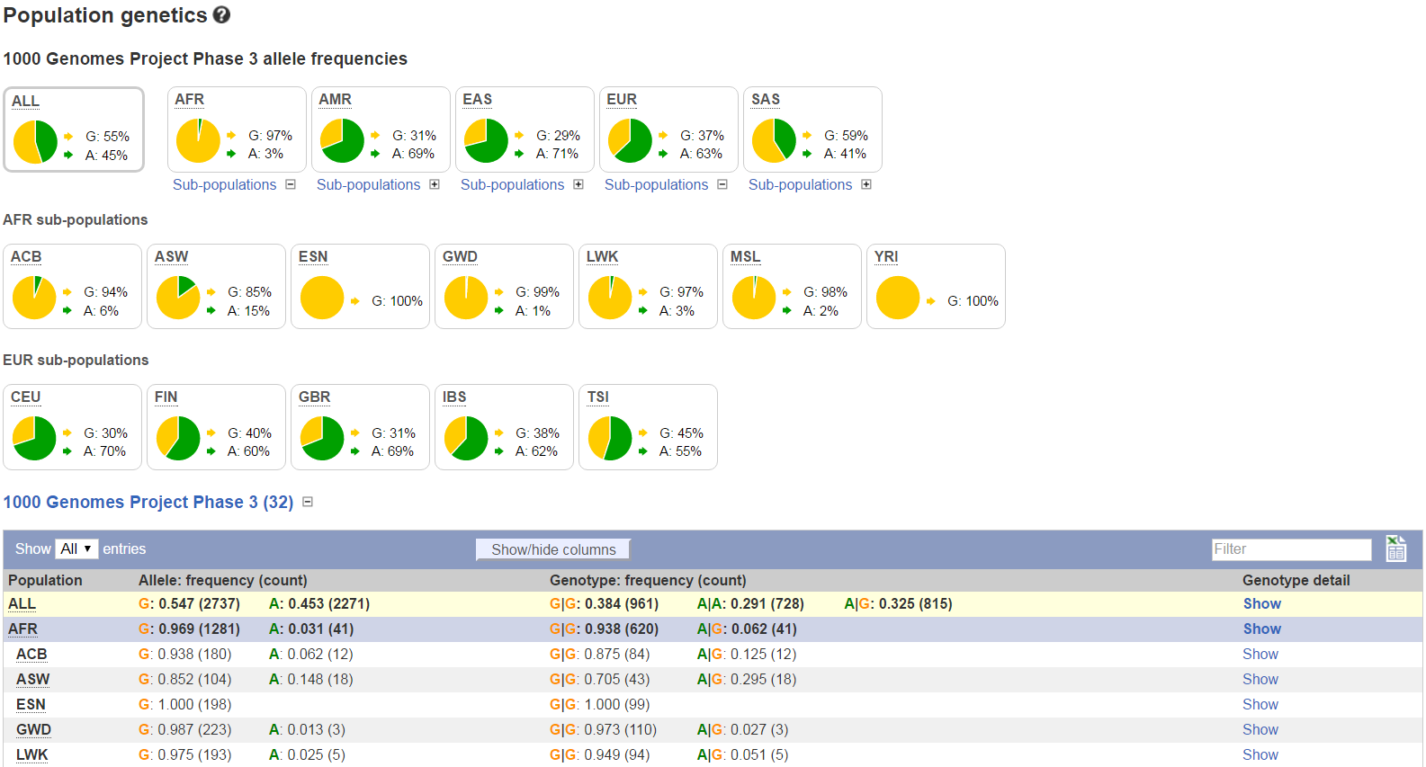
Ensembl … Exploring variants …
Population genetics
These data are mostly from the 1000 genomes and HapMap projects in human.
There are big differences in allele frequencies between populations.
Pie charts of allele frequencies
Expand subpopulations
Tables of more detailed data

Slide 22
Ensembl … Exploring variants
Let’s have a look at the phenotypes associated with this variant.

Slide 23
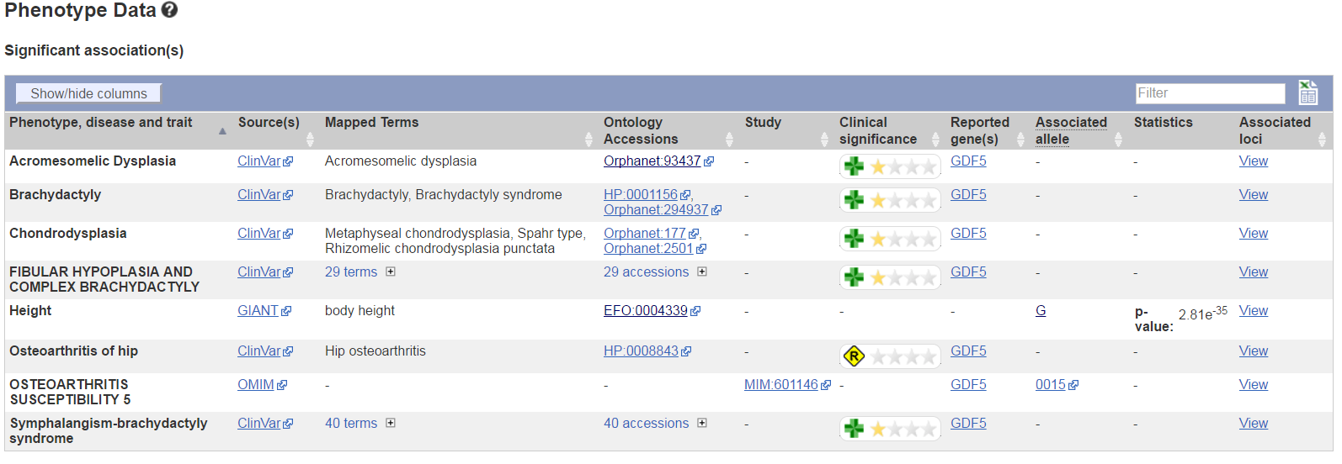
Ensembl … Exploring variants …
Phenotypes
This variant is associated with 8 phenotypes

Slide 24
Ensembl … Exploring variants
Let’s have a look at the citations of the variant.

Slide 25
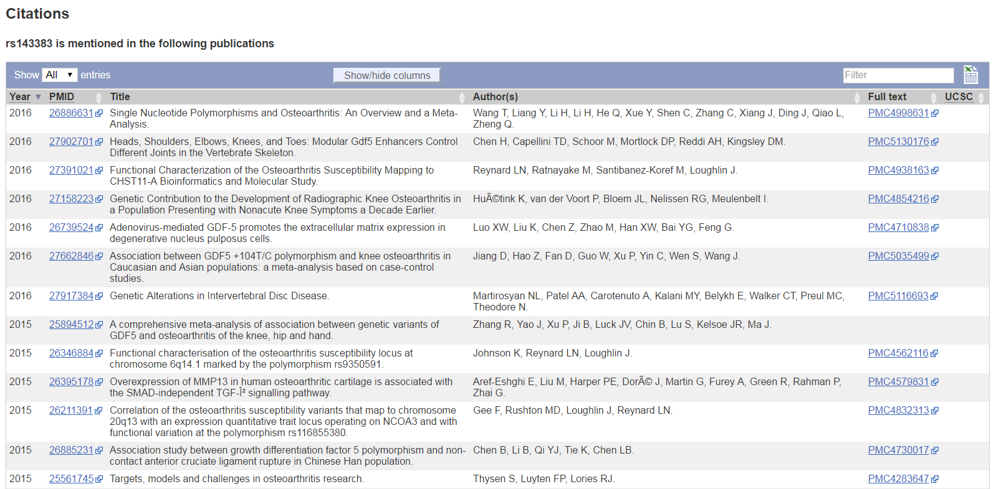
Ensembl … Exploring variants …
Citations

Slide 26
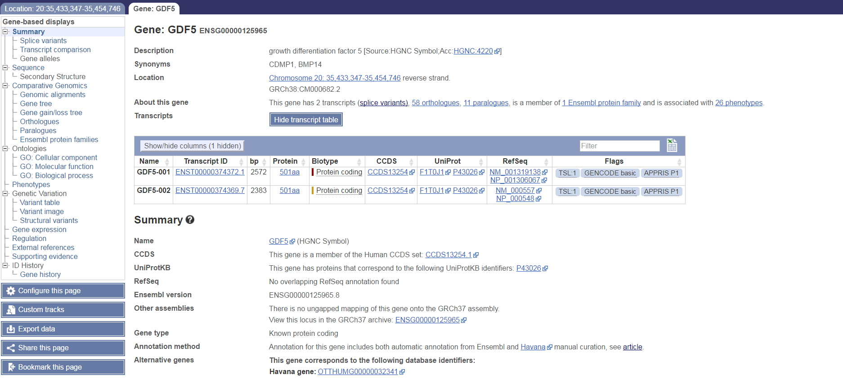
Ensembl … Exploring genes
Let’s have a look at GDF5 (growth differentiation factor 5).

Slide 27
Ensembl … Exploring variants … Exercise 2
Explore our top signal, rs9641123.
What type of variants is?
Where is this variant located (chr - position - strand)?
Are there big differences in allele frequencies between populations?
What is the ancestral allele frequency in the Yoruba (YRI) population from the 1000G set?
What is the least frequent genotype for this variant in the Yoruba (YRI) population from the 1000G set?
In how many transcripts is this variant found?
Are all transcripts from the same gene?
How many and which consequence type are predicted for this variant?
How many phenotypes are associated with this variant?
How many phenotypes are associated with the gene that this variant is located in?
How many publications refer to rs9641123?

Slide 28
Publicly available bioinformatics
resources
Genome Browsers
Nucleotide Sequence Databases
Protein Sequence Databases
Database Searching by Sequence Similarity
Protein Domains: Databases and Search Tools
Human Traits & Diseases Databases
Phylogeny & Taxonomy
Databases of other Organisms
Gene Prediction
Gene Expression Databases
Gene Regulation
Metabolic, Gene Regulatory & Signal Transduction Network Databases
Publications Database

Slide 29



Human Traits & Diseases Databases
GWAS catalog (https://www.ebi.ac.uk/gwas/ )
OMIM (http://omim.org/ )
Orphanet (http://www.orpha.net )

Slide 30
Human Traits & Diseases Databases
“GWAS catalog” is a catalog of published genome-wide association studies.
Let’s have a look at a specific variant, rs143383.
No results found for search term rs143383!!!

Slide 31
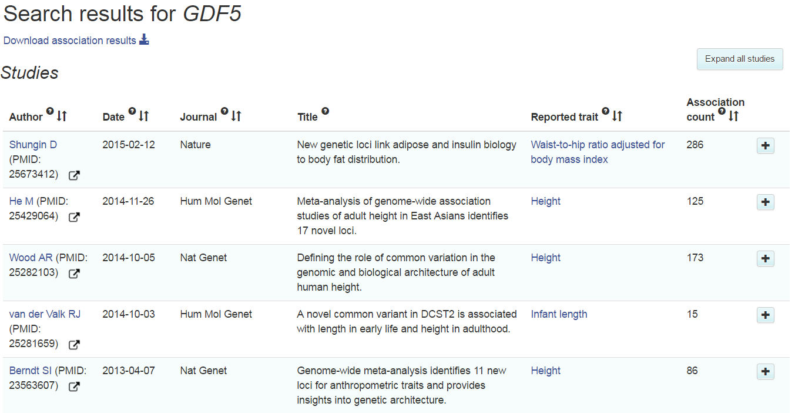
Human Traits & Diseases Databases
Let’s have a look at GDF5.

Slide 32
Human Traits & Diseases Databases …
Exercise 3
1. Try to find more information about our top variant (rs9641123) and the gene that is located in GWAS catalogue and OMIM databases.

Slide 33
Publicly available bioinformatics
resources
Human Genome Browsers
Nucleotide Sequence Databases
Protein Sequence Databases
Database Searching by Sequence Similarity
Protein Domains: Databases and Search Tools
Human Traits & Diseases Databases
Phylogeny & Taxonomy
Databases of other Organisms
Gene Prediction
Gene Expression Databases
Gene Regulation
Metabolic, Gene Regulatory & Signal Transduction Network Databases
Publications Database

Slide 34
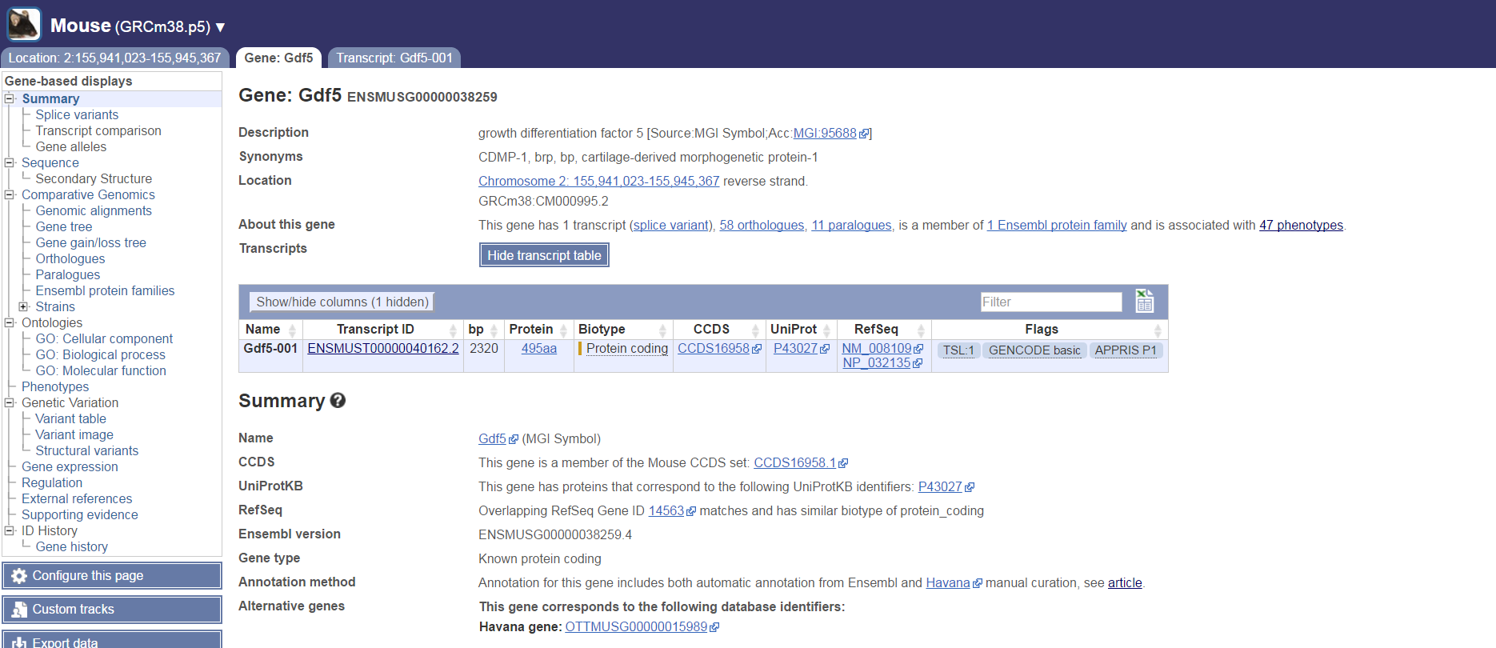
Databases of other Organisms
Mouse: http://www.ensembl.org/Mus_musculus/Info/Index

Slide 35
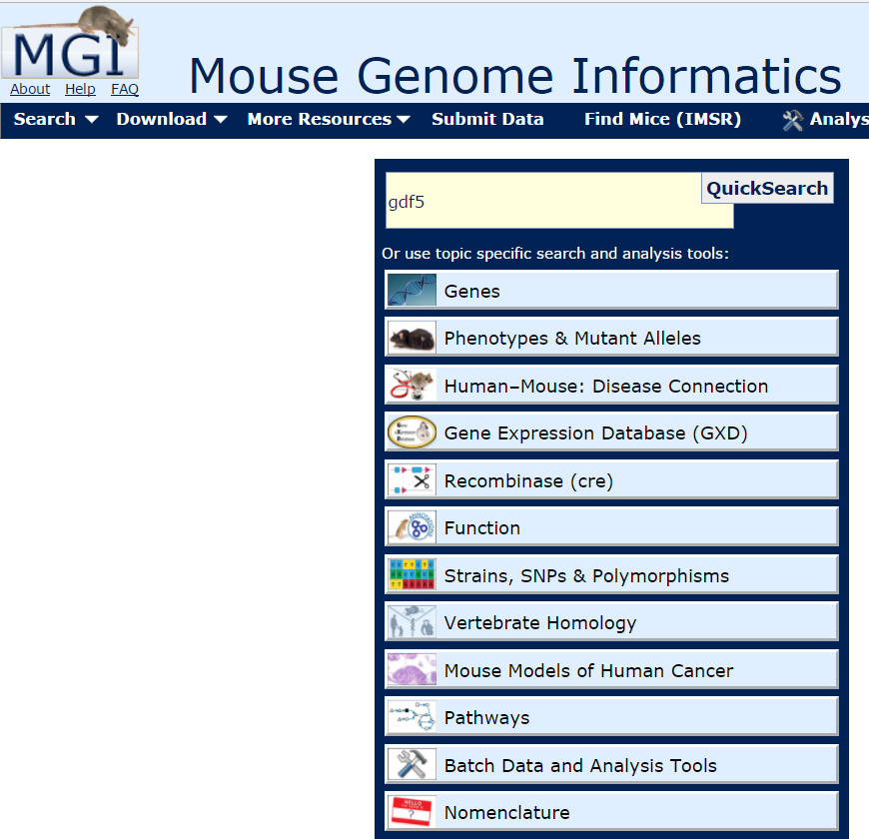
Databases of other Organisms
Mouse: http://www.informatics.jax.org/

Slide 36
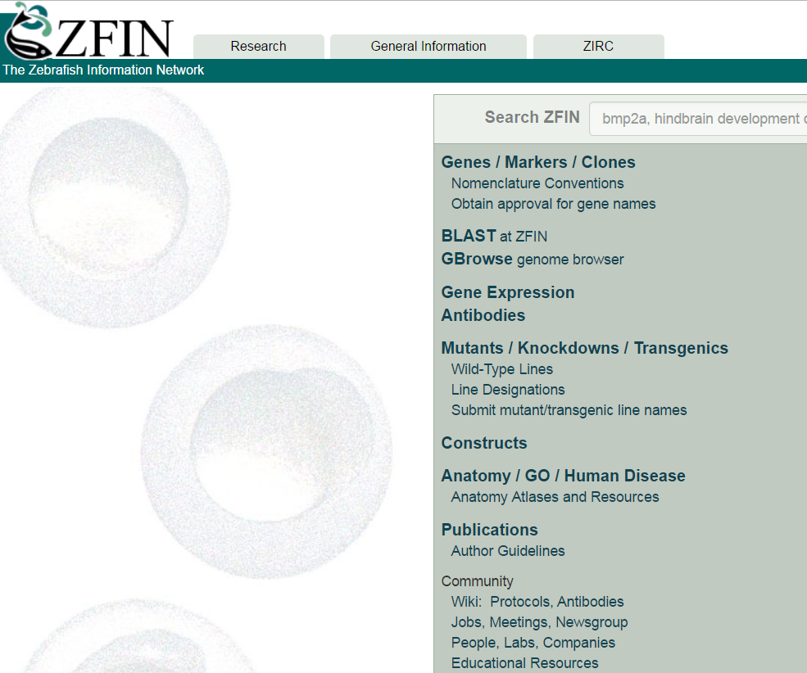
Databases of other Organisms
Zebrafish: http://zfin.org/

Slide 37
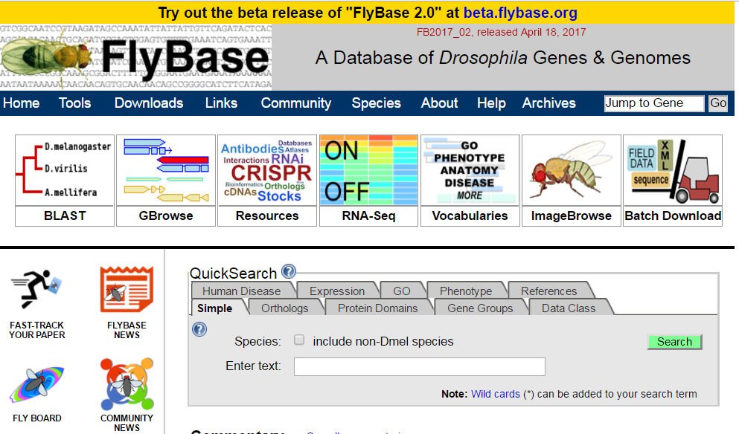
Databases of other Organisms
Drosophila: http://flybase.org/

Slide 38
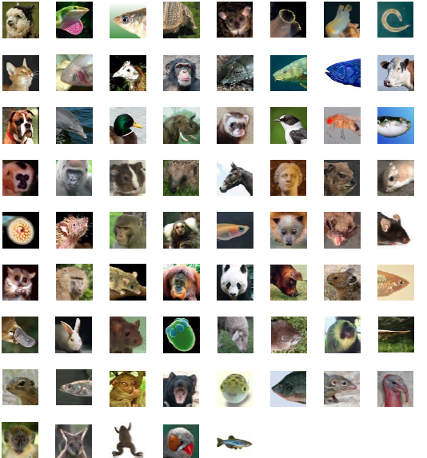
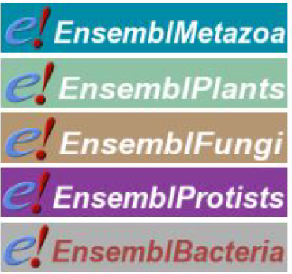
Databases of other Organisms
Ensembl : Nearly 70 vertebrate species & >40000 genomes from other species

Slide 39
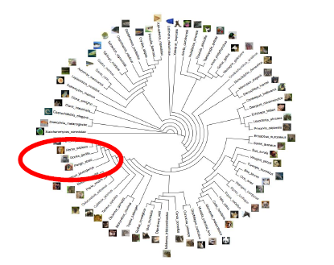
Databases of other Organisms …
Exercise 4
Explore our top variant in the databases of other organisms.
Hint: you can search by gene id or phenotype.

Slide 40
Publicly available bioinformatics
resources
Genome Browsers
Nucleotide Sequence Databases
Protein Sequence Databases
Database Searching by Sequence Similarity
Protein Domains: Databases and Search Tools
Human Traits & Diseases Databases
Phylogeny & Taxonomy
Databases of other Organisms
Gene Prediction
Gene Expression Databases
Gene Regulation
Metabolic, Gene Regulatory & Signal Transduction Network Databases
Publications Database

Slide 41
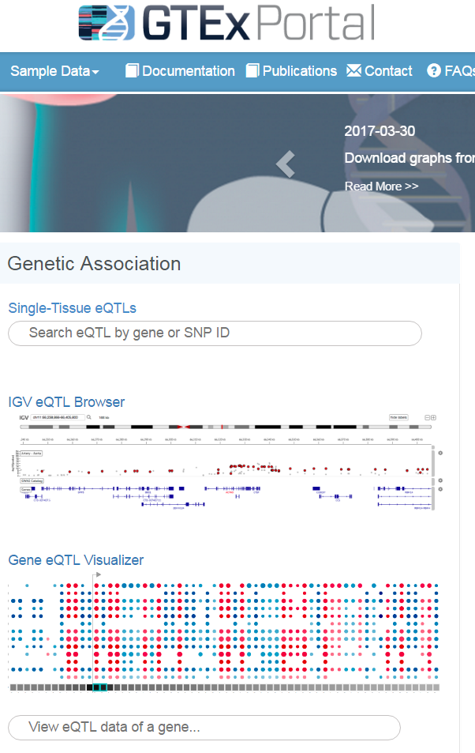
Gene Expression Databases
Genotype-Tissue Expression (GTEx) : Correlations between genotype and tissue-specific gene expression (https://www.gtexportal.org/home/).

Slide 42
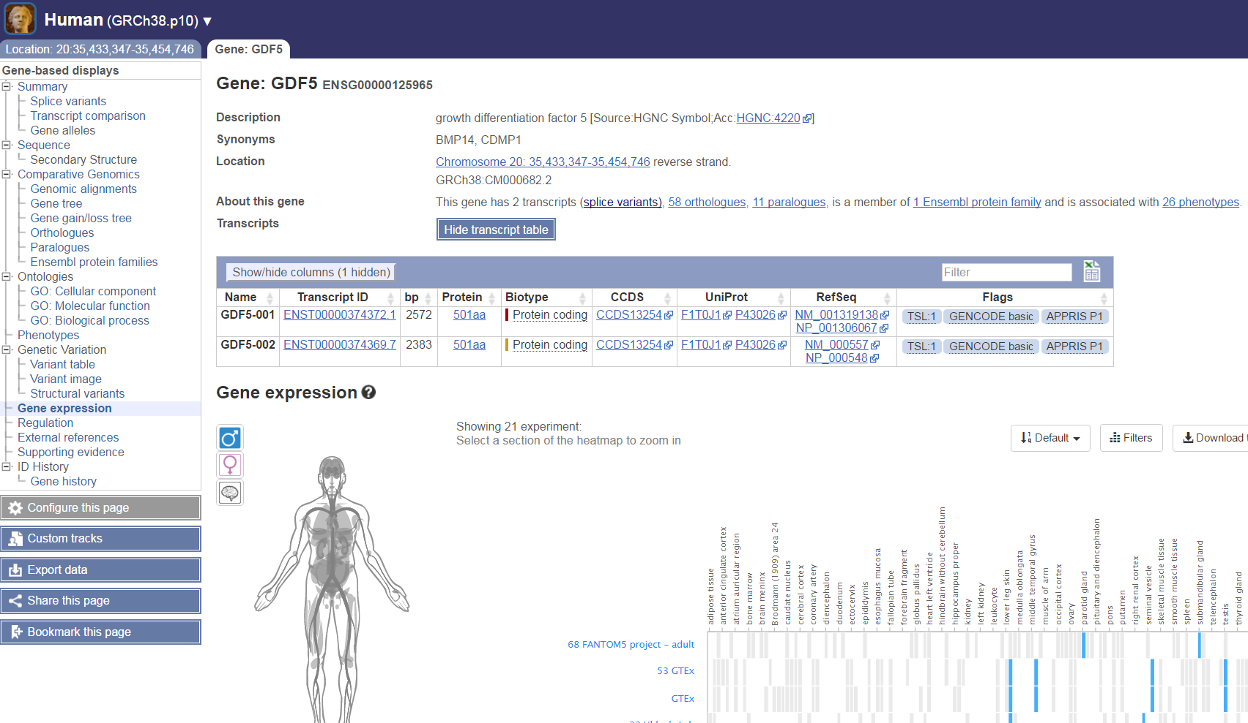
Gene Expression Databases
Expression Atlas: Differential and Baseline Expression (http://www.ebi.ac.uk/gxa/home or through Ensembl).

Slide 43
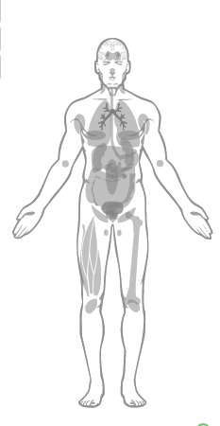
Gene Expression Databases …
Exercise 5
Does our top variant affect the expression of the gene?
Hint: Use GTEx portal
Osteoporosis is characterized by reduced bone mass. Is CALCR expressed in bone related tissues?
Hint: Use Expression Atlas

Slide 44
Publications Database
Genome Browsers
Nucleotide Sequence Databases
Protein Sequence Databases
Database Searching by Sequence Similarity
Protein Domains: Databases and Search Tools
Human Traits & Diseases Databases
Phylogeny & Taxonomy
Databases of other Organisms
Gene Prediction
Gene Expression Databases
Gene Regulation
Metabolic, Gene Regulatory & Signal Transduction Network Databases
Publications Database

Slide 45
Publications Database
PubMed (https://www.ncbi.nlm.nih.gov/pubmed) comprises over 26 million citations.
How do I search PubMed?
Identify the key concepts for your search.
Enter the terms* in the search box.
Keywords
Author name
Journal name
…..
Suggestions will display as you type your search terms.
Click Search.

Slide 46
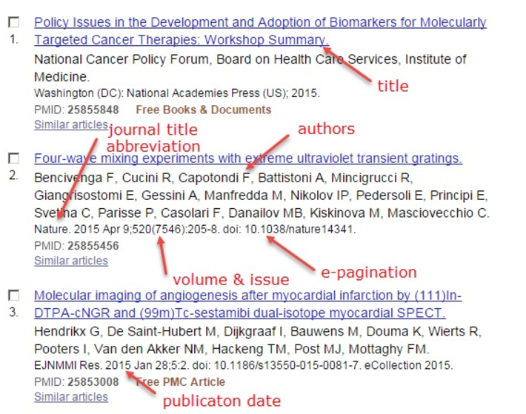
Publications Database
Anatomy of the summary results:

Slide 47
Publications Database … Exercise 6
Try to find more information about our top variant and the gene that is located.
Can you find a paper for which:
“Lopes” is one of the authors
Dealing with “osteoarthritis”
The name of the journal is “Lancet”

Slide 48
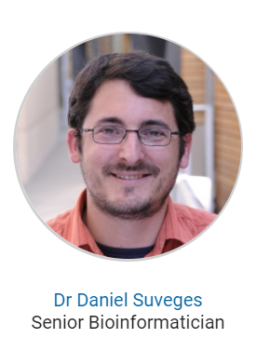
Team144 pipeline
Variant:
Gene:
Ensembl:
position,
consequences (transcript and regulatory region),
1kG frequencies,
GWAS signals around the variant,
regulatory marks around the variant
nearby genes.
ExAC: allele frequencies
GTEx: associated gene.
Pubmed: papers where the variant is cited.
Ensembl:
Position
Associated phenotypes
Gene ontology annotations
Uniprot:
Function, Tissue, Localization, Disease
OMIM:
gene annotation
associated diseases
GWAS catalog:
Associated variants and association details.
Gene Expression Atlas:
Tissues in which expression of the gene was observed
GTEx:
List of variants that affects the expression of the gene.
Mouse Genomics Informatics:
Mouse phenotype of the gene.

Slide 49
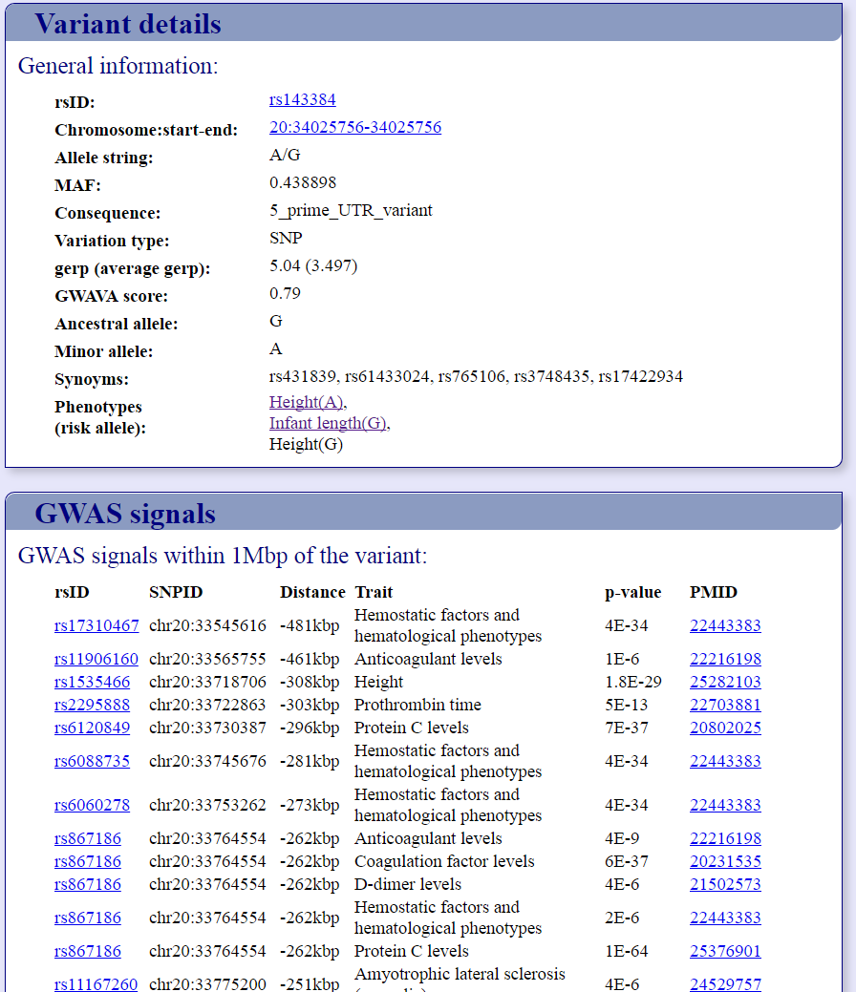
Team144 pipeline

Slide 50
Publicly available bioinformatics resources
Thank you!
Volos Summer School
30 / 05 / 2017
Konstantinos Hatzikotoulas

Slide 51
Ensembl … the front page … Exercise 1
… Answers
Go to the species homepage for Panda. What is the name of the genome assembly for Panda?
Assembly ailMel1 or GCA_000004335
How long is the Panda genome (in bp)? How many genes have been annotated?
2,245,312,831
19,343
Repeat for Human.

Slide 52
Ensembl … more than a browser!
Need more help?
● Check Ensembl documentation
● Watch video tutorials on YouTube
● View the FAQs
● Try some exercises
● Read some publications
● Go to our online course

Slide 53
